Slide 1
Sales Analysis of Top-Selling Products and Categories on Walmart’s E-Commerce Platform
By Ahsan Mubarak

Slide 2
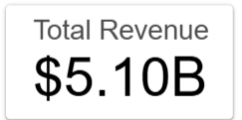
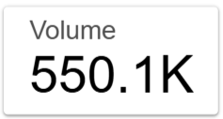
Business Context & Objective
Context:
Walmart is one of the largest e-commerce platforms, handling millions of transactions daily with a diverse range of products. As a market leader, Walmart must continually optimize its top-performing products and categories to stay competitive in the global market.
Objective:
This analysis aims to evaluate product and category performance in terms of total sales (revenue) and sales volume. The primary focus is on identifying which products and categories contribute the most to overall revenue.

Slide 3
Dataset Overview
Dataset: Walmart E-commerce
Source: Kaggle - Walmart E-commerce
Walmart is a global retail giant known for offering a wide range of products at competitive prices and providing a convenient shopping experience for millions of customers worldwide.
This dataset includes:
Product_ID
User_ID
Product_Category
Purchase

Slide 4
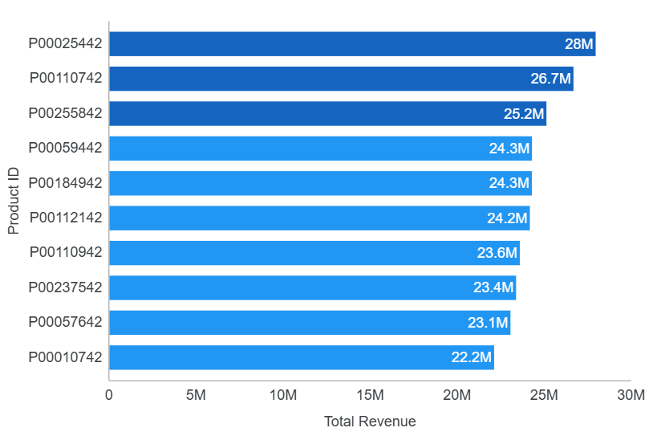
Revenue by Product ID
Insight:
Product P00025442 generated the highest revenue with USD 26.7 million, followed by P00110742 (USD 26.7 million) and P00255842 (USD 25.1 million).
No single product dominates; the revenue gap between products is relatively small, indicating that demand is evenly spread across multiple products.

Slide 5
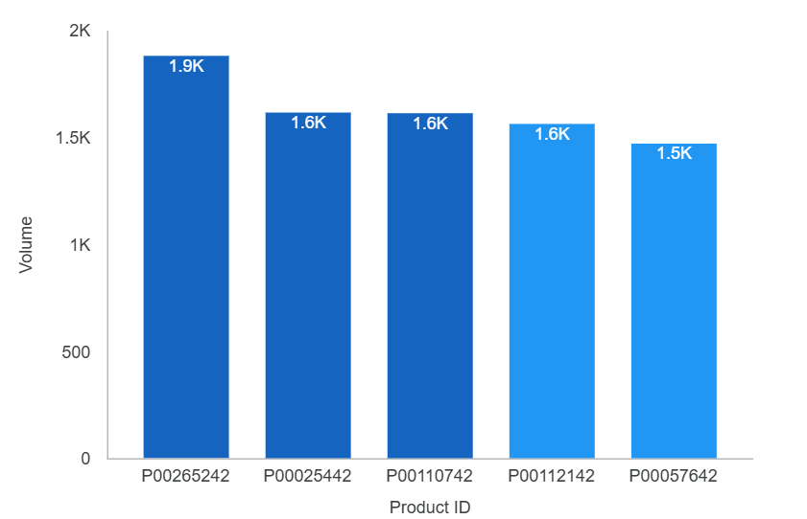
Volume by Product ID
Insight:
Product P00265242 recorded the highest purchase volume with 1,880 sales, yet it did not appear in the top 10 revenue products.
Meanwhile, P00025442 and P00110742, ranking first and second in revenue, also had high sales volumes of 1,615 and 1,612 respectively, with only a small gap of 3 units.

Slide 6
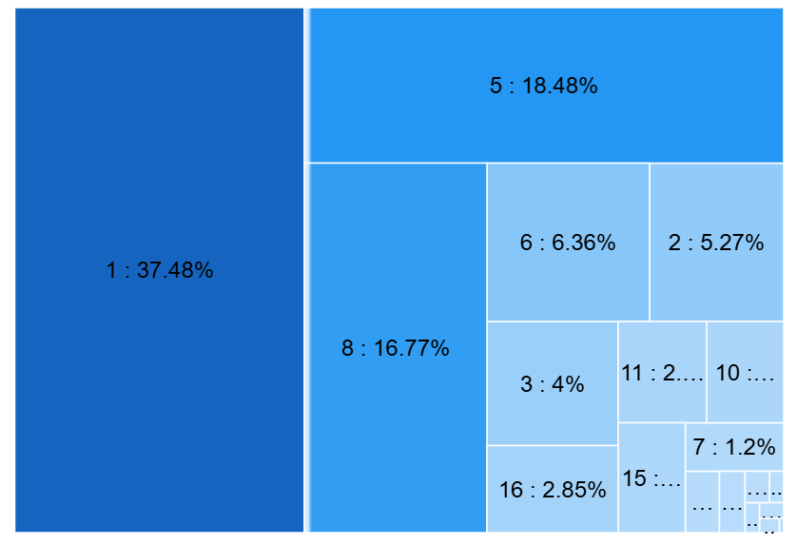
Revenue Distribution by Product Category
Insight:
Category 1 contributes 37.48% of total revenue.
Category 5 generates USD 941.8 million, and Category 8 generates USD 854.3 million.
These three categories together contribute approximately 72% of total revenue, showing Walmart’s strong position in these categories.

Slide 7
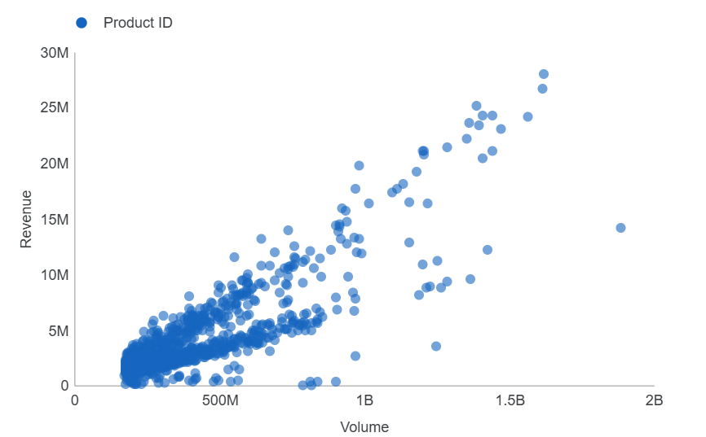
Relationship Between Product Volume and Revenue
Insight:
There is a strong positive correlation between product volume and revenue.
The higher the sales volume, the greater the revenue generated.

Slide 8
Final Insight and Recommendation
Final Insight:
Revenue is relatively balanced across the top products, but it is dominated by Category 1, Category 5, and Category 8, which together contribute around 72% of total revenue.
Volume and revenue show a strong positive correlation.
Recommendation:
Focus on enhancing the performance of the top 3 categories.
Run product campaigns or promotions to increase visibility and sales for these products.

Slide 9
Final Insight and Recommendation
Recommendation:
Evaluate pricing strategies for high-volume but low-revenue products. For instance, P00265242 may benefit from upselling or bundling to increase its revenue impact.
Review price differences between similar-volume products, such as comparing P00110742 and P00025442, to understand the impact of pricing on revenue.
Add more visibility to products with growing volume. If any product is trending in volume, support it with promotions to convert that into revenue.
Monitor outliers over time. Keep track of products with unusually high performance — they might become new best-sellers or signal shifting demand.

